Slide 1
Chapter 1
Introduction

Slide 2


Slide 3
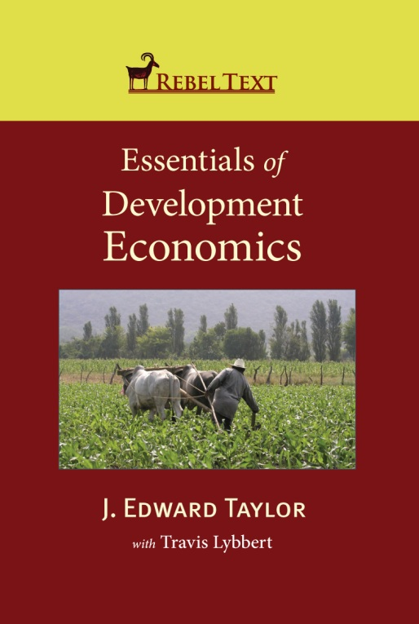
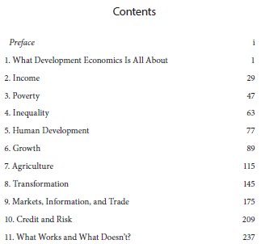
Book (The Core of this Course)
Additional required readings will be posted on the course websites each week:
Rebeltext.org (public domain)
Smartsite (specific to our class)

Slide 4
What Is Development Economics?
Everything: Just pick up a traditional textbook (or look in RebelText)
So why have a field of development economics?
  There must be something different about poor countries. What is it?
Book: How our thinking about development has evolved

Slide 5
Evolution of Development Thought
Growth
Inequality and Poverty
Trusting Markets
Not Trusting Markets
The Experimental Revolution
Overview in Chapter 1; we’ll cover all of these in this class

Slide 6
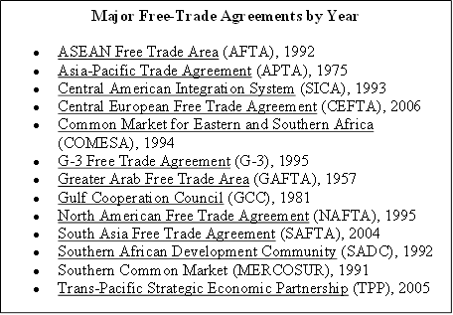
Trusting (International) Markets

Slide 7
Back to the Bigger Question: What’s Development?
Economic development entails far-reaching changes in the structure of economies, technologies, societies, and political systems.
Development economics is the study of economies that do not fit many of the basic assumptions underpinning economic analysis in high-income countries
  Including well-functioning markets, perfect information, and low transaction costs.
When these assumptions break down, so do the most basic welfare and policy conclusions of economics
  And we need new economic tools.

Slide 8
Efficiency Versus Equity
Rich countries: seen as separate
  Grow the pie, then figure out how it gets divvied up
In Poor countries: Equity and efficiency cannot usually be separated

Slide 9
Why Efficiency Cannot Be Separated from Equity
Banks are unwilling to loan money to small farmers
Poor people cannot get insurance to protect themselves against crop loss or sickness
Poverty and malnutrition prevent kids from growing up to become productive adults
Access to markets for the stuff people produce, the inputs they use, and the goods they demand is different for the poor and rich
The ability to get a job depends on who you are, not on how productive you are
No more student loans?

Slide 10
What Is Economic Development?
Is it growth?

Slide 11
But Careful: Costa Rica vs. Equatorial Guinea
Infant Mortaity

Slide 12
Income and Growth
In rich countries: development and growth are seen as similar
  E.g., think about urban development projects
A lot of things correlate with income
  Life expectancy is higher in the US than Malawi
But most development economists would say development is different from growth
  …though it’s hard to have development without growth

Slide 13
What Development Projects Focus On
Concrete outcomes related to poverty, malnutrition, inequality, and health.
Basic physical needs like nutrition, shelter, and clothing
Development of the mind (and of course people’s earnings potential), through education.
The environment, conservation, and sustainable resource use
Human rights, gender and ethnic equity
Government corruption.

Slide 14
So What Is Development Then?
What Does the UN Say?
(The Millennium Development Goals) http://www.youtube.com/watch?v=vddX4n30sXY

Slide 15
Millennium Development Goals
Set of targets adopted by 189 nations in Sept. 2000 (specific targets for each; p. 51)
  1. Eradicate extreme poverty and hunger
  2. Universal primary education
  3. Ender equity, empowerment of women
  4. Reduce child mortality
  5. Improve maternal health
  6. Combat HIV/AIDS, malaria, other diseases
  7. Environmental sustainability
  8. Develop a global partnership for development
Some on track, others not (esp. child mortality, gender equity in school enrollment)
Effects of current crisis worrisome
Per-capita income growth “increases the range of human choice” (W. Arthur Lewis, 1995, The Theory of Economic Growth)

Slide 16
What Happens When Countries Develop?
Social indicators improve (Chapters 3-5)
  Health: Life expectancy, infant mortality
  Education: Literacy, higher education
Structure of economy changes (Chapter 8)
  Shift from agriculture to higher-paying urban jobs
  Expansion of markets
    Spatial
    Varieties: inputs, outputs, credit, insurance, futures
Institutions develop and deepen (Chapters 9-10)
  Legal, market, government, etc.
    Ex: Contracts and Real Estate
Accelerating then decelerating population growth (the population transition)
  Emigration to immigration (the migration transition)
Application of science to problems of production

Slide 17
Things to Keep in Mind:
1. Globalization
Globalization (p. 8): Integration of national economies into the international economy through international flows of:
  Goods and services
  Direct foreign investment
  Short-term capital flows
  People
  Technology
No one is isolated anymore

Slide 18
2. History and Geography Matter
Tradition of education vs. illiteracy
Highly developed institutions and commerce, finance, transport run by locals vs. monopolized by colonizers
Common language and culture
Traditions of self-government and government institutions (vs. late independence)
Geography favorable to development

Slide 19
3. There are “Substitute” Paths to Development
Do poor countries have to go through same process as rich countries? A: No.
  Ex: S. Korea, steel
Most successful countries share certain characteristics:
  Capable government
  Reasonably efficient markets and institutions
  Health and educated population
BUT there are big differences: for most “prerequisites” to development there are substitutes
  E.g.: Capital accumulation for the industrial revolution (England) versus
    mobilization of international savings (Germany)
    Taxing power of the state (19th C. Russia, Meiji Japan)
  Sometimes foreign resources (money, people) can be substitutes when these resources are scarce locally—but careful!
  The world’s second largest agricultural exporter: (Guess)

